Slide 1
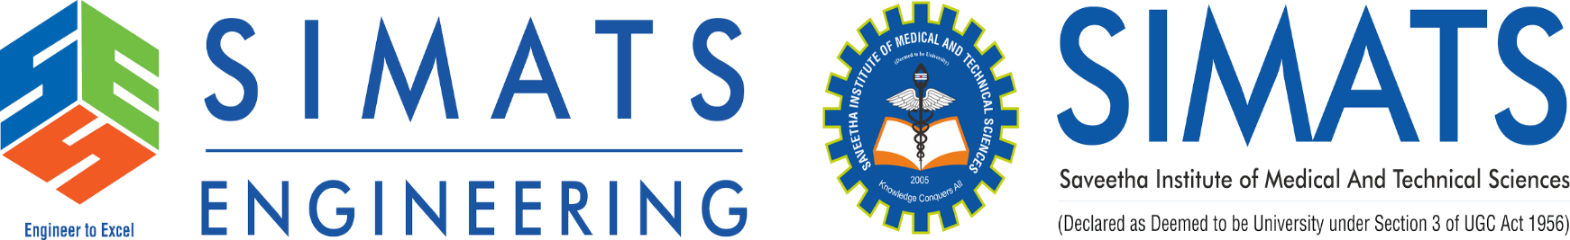
GestureTalk AI: Intelligent Indian Sign Language Recognition and Communication System
CSA1707 - ARTIFICIAL INTELLIGENCE
Under the Guidance of:
DR. Krishna Kumar Kathiresan
Professor, Department of CSE
SIMATS Engineering
Presented By:
R. Mohanram – 192521117
B. Pradeep kumar -1925260156

Slide 2


Introduction
Overview of the project:
GestureTalk AI is an intelligent communication system that recognizes Indian Sign Language (ISL) through a webcam or uploaded videos and converts signs into text and speech. It also supports reverse communication through text or speech input.
Scope
The project uses OpenCV, MediaPipe and deep learning for hand, face and body detection, sign recognition, and confidence-based error recovery. It includes two-way communication and personalized recognition, initially focusing on a selected ISL vocabulary.
Under the Guidance of:
Dr. S. Ponmaniraj
Dr. Vijayaragavan. P
CSA0284 C programming for Data Recovery
Date: 20/11/2025

Slide 3
Problem Identification
Communication between Deaf and hard-of-hearing individuals and hearing people remains challenging when they do not share a common language. Existing communication methods may require interpreters or manual text entry, limiting convenient real-time interaction.
A comprehensive sign-language communication system must recognize static and dynamic signs, handle variations between signers, interpret continuous sequences, manage uncertain predictions, and convert recognized communication into understandable text or speech.
GestureTalk AI proposes an integrated AI-based solution combining machine learning, temporal sequence recognition, adaptive learning, confidence-based validation, and language processing to support accessible two-way communication.

Slide 4
Objectives
Develop an AI-based system for recognizing Indian Sign Language signs.
Recognize fingerspelling, vocabulary signs, dynamic gestures, and two-handed signs.
Apply temporal learning to understand sequences of sign movements.
Improve recognition through signer adaptation and confidence-based error handling.
Convert recognized signs into text and speech.
Support text or speech input for sign-based communication.
Integrate the modules into a unified, accessible communication platform.

Slide 5
Literature Review
Author & Year | Title / Focus | Main Contribution | Relevance to GestureTalk AI
Sridhar et al., 2020 ai4bharat/INCLUDE at main +1 | INCLUDE: A Large Scale Dataset for Indian Sign Language Recognition | Introduces a large-scale dataset for isolated ISL sign recognition. | Supports dataset selection and training of sign-classification models.
Joshi et al., 2023 exploration-lab.github.io | ISLTranslate: Dataset for Translating Indian Sign Language | Presents ISL-English sentence-pair data for sign-language translation. | Provides background for converting sign-language sequences into text.
Joshi et al., 2024 ACL Anthology | iSign: A Benchmark for Indian Sign Language Processing | Introduces an ISL processing benchmark with video-text data and multiple tasks. | Supports future sign-to-text translation and text-to-sign representation.
Damdoo and Kumar, 2025 Wiley Online Library | An Integrative Survey on Indian Sign Language Recognition and Translation | Reviews recognition methods, datasets, deep-learning approaches, and research challenges. | Helps identify gaps in continuous recognition, robustness, and two-way communication.
Kirandevraj et al., 2025 ACL Anthology | Continuous Fingerspelling Dataset for Indian Sign Language | Introduces aligned video-text data for continuous ISL fingerspelling. | Supports future development of sequential gesture recognition and sign-to-text conversion.

Slide 6
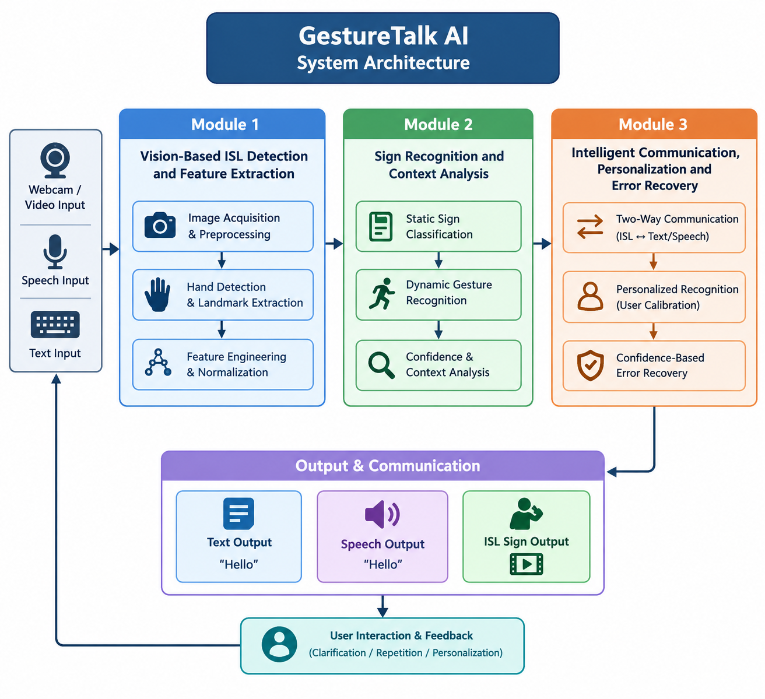

Slide 7
Software Requirements
Programming Language: Python 3.10
IDE: Visual Studio Code
Computer Vision: OpenCV
Hand Landmark Detection: MediaPipe Tasks API
Machine Learning: Scikit-learn
detection stage
Deep Learning: PyTorch
Data Processing: NumPy, Pandas
Speech Recognition: Speech-to-Text library/API
Speech Output: Text-to-Speech library
User Interface: Streamlit
Data Visualization: Matplotlib
Version Control: Git and GitHub
Model/Data Storage: CSV, NumPy files, and trained model files
Google AI Studio

Slide 8
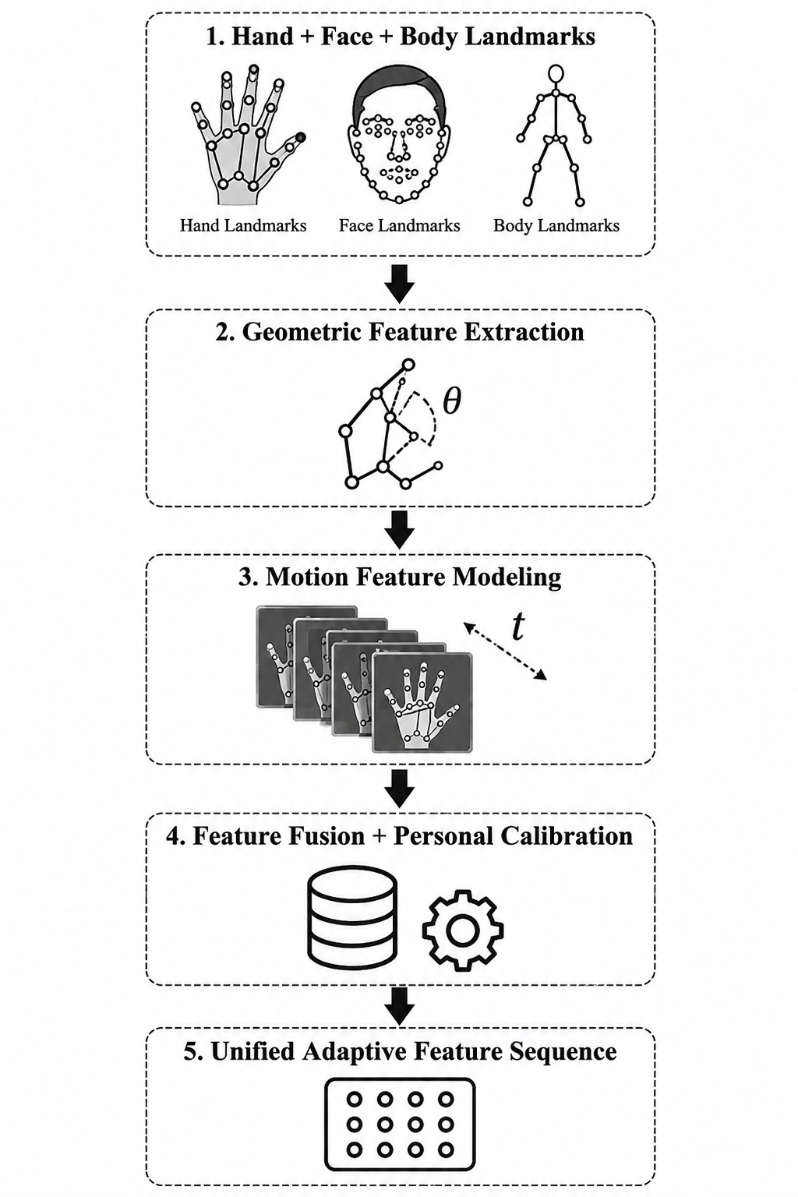
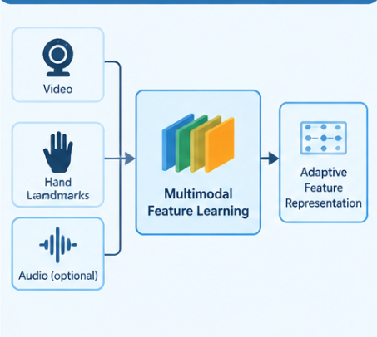
Module 1: Intelligent Feature Learning and Adaptive Personalization
Purpose: To learn useful representations of sign-language input and improve recognition across different signing styles.
This module prepares structured features from hand, body, and facial landmarks. It normalizes the input and supplies consistent representations to the recognition models.
Key functions:
Extract and organize relevant sign features.
Learn patterns that distinguish sign categories.
Represent changes in hand position and movement.
Adapt recognition to individual signing styles using suitable training or adaptation methods.
Improve generalization across recording conditions and users.
Expected output: Structured features suitable for static sign classification and dynamic sequence recognition.

Slide 9
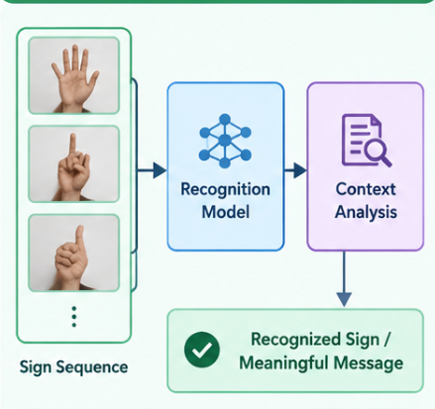
Module 2: Intelligent Sign Recognition and Temporal Sequence Learning
Purpose: To identify signs from extracted features using appropriate AI models.
The module combines different recognition approaches:
Static sign recognition: Classifies stable hand configurations and supported fingerspelling categories.
Dynamic sign recognition: Uses LSTM or suitable Transformer architectures to learn movement patterns over time.
Two-handed sign recognition: Analyzes coordinated features from both hands.
Continuous sign recognition: Processes longer sequences to identify sign boundaries and produce a sequence of recognized signs.
The selected models are trained using labelled sign-language datasets. Their performance is evaluated using accuracy, precision, recall, F1-score, and signer-independent testing where possible.
Expected output: Predicted sign labels or sign sequences with associated confidence information.

Slide 10
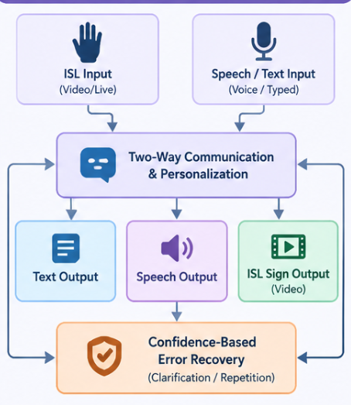
Module 3: Context-Aware Interpretation and Intelligent Communication
Purpose: To validate sign predictions and convert the recognized information into useful communication output.
Key functions:
Stabilize predictions across consecutive frames.
Identify uncertain results using validated confidence thresholds.
Flag potentially unfamiliar signs and request repetition when necessary.
Use language-processing techniques to improve sequence interpretation where suitable.
Convert accepted recognition results into text.
Generate speech from text using a text-to-speech engine.
Support reverse communication through a dedicated text/speech-to-sign component.
Expected output: Interpreted sign information presented as text or speech, with a pathway for two-way communication.

Slide 11
system workflow
The user provides sign-language video or text/speech input.
The system extracts and prepares the relevant visual or linguistic features.
The AI recognition layer classifies static signs or analyzes dynamic sequences.
The validation layer checks prediction stability and uncertainty.
The interpretation layer processes the recognized sequence where supported.
The system generates readable text and optional speech.
For reverse communication, text or speech is converted into an appropriate sign representation using a dedicated sign-generation component.

Slide 12
results
The completed system is intended to provide:
Recognition of a broad vocabulary of ISL signs.
Improved recognition of dynamic and two-handed gestures.
More stable predictions across different signers.
Confidence-based handling of ambiguous or unfamiliar inputs.
Text and speech output from recognized signs.
A foundation for continuous sign-sequence interpretation.
A two-way communication interface.
The final performance will be demonstrated through evaluation on a sufficiently large, diverse dataset. Accuracy figures must be added only after the corresponding final model has been tested.

Slide 13
Conclusion and Future enhancement
Conclusion
GestureTalk AI proposes an intelligent and adaptive sign-language communication system that integrates feature learning, machine learning, temporal sequence recognition, prediction validation, and language processing.
Its final design aims to bridge communication between sign-language users and hearing individuals through accessible text and speech interfaces, while providing a pathway toward continuous recognition, personalization, and two-way interaction.
Future enhancement
Expand training data to cover a wider range of ISL vocabulary and signers.
Improve continuous sign recognition and sentence-level interpretation.
Develop robust recognition of two-handed signs and non-manual signals.
Explore advanced Transformer architectures and signer adaptation.
Improve uncertainty estimation and automatic error recovery.
Develop sign-language generation using validated sign representations or animation.
Optimize the system for mobile and edge devices.
Evaluate the system with Deaf and hard-of-hearing users in real-world settings.

Slide 14
References
[1] A. Sridhar, R. G. Ganesan, P. Kumar, and M. Khapra, “INCLUDE: A Large Scale Dataset for Indian Sign Language Recognition,” in Proc. ACM Int. Conf. Multimedia, 2020, pp. 1366–1375. https://doi.org/10.1145/3394171.3413528
[2] A. Joshi et al., “ISLTranslate: Dataset for Translating Indian Sign Language,” Findings of the Association for Computational Linguistics: ACL, 2023.
[3] A. Joshi et al., “iSign: A Benchmark for Indian Sign Language Processing,” Findings of the Association for Computational Linguistics: ACL, pp. 10827–10844, 2024. https://doi.org/10.18653/v1/2024.findings-acl.643
[4] R. Damdoo and P. Kumar, “An Integrative Survey on Indian Sign Language Recognition and Translation,” IET Image Processing, vol. 19, no. 1, Art. no. e70000, 2025. https://doi.org/10.1049/ipr2.70000
[5] R. Kirandevraj, V. K. Kurmi, V. P. Namboodiri, and C. V. Jawahar, “Continuous Fingerspelling Dataset for Indian Sign Language,” in Proc. Workshop on Sign Language Processing (WSLP), 2025, pp. 33–38. https://doi.org/10.18653/v1/2025.wslp-main.6

Slide 15
Thank You!

